Slide 1
Data Manipulation - Part 1
Jeremy Bergmann - Omaha Data Science Academy

Slide 2
Quiz: Class 1 – DMM Basics
What is the need for Data Manipulation & Management?
What is SQL? What is a database?
How do you store data in a Database?
What are the common SQL clauses?
What are the common aggregations/functions?
How to you utilize comments for debugging or explaining code?
What are the various SQL function types?
What is a subquery, and what is its purpose?
Notes:
SELECT column
FROM table_name
WHERE conditions
GROUP BY column
ORDER BY column
Write a summary of the information as if explaining to a 14 year old. Avoid jargon Keep the words and sentences simple Rely on memory Make the explanation visual, if possible Note where you had difficulty or have knowledge gaps. These indicate things you should review, research, or ask questions about

Slide 3
Class 2 Objectives
Part 1 - Data Storage
Create and delete databases
Create and delete tables
Create tables with constraints
Add and delete table fields
Add and delete table constraints
Create and delete views
Part 2 - Data Manipulation
SQL Joins - inner, outer and left
Union & Union All
Notes:
Feynman technique: Learn -> Explain -> Reflect -> Repeat
What are the most important ideas from last class? Write a summary of the information as if explaining to a 14 year old. Avoid jargon Keep the words and sentences simple Rely on memory Make the explanation visual, if possible Note where you had difficulty or have knowledge gaps. These indicate things you should review, research, or ask questions about

Slide 4
What is the need for data manipulation?
Creating new datasets & Combine disparate data sets
Perform common queries, aggregations, and joins
Adding, removing, or modifying data
Storing, Updating & Extracting Data
Creation/Extraction
Transformation data
Cleaning data
Storage & Retrieval
Part 2
Part 1
Notes:
Creation: creating tables and databases, the things
Storage: where data are stored
Cleaning: adding, removing, or modifying data
Retrieval: selecting only the data you want

Slide 5
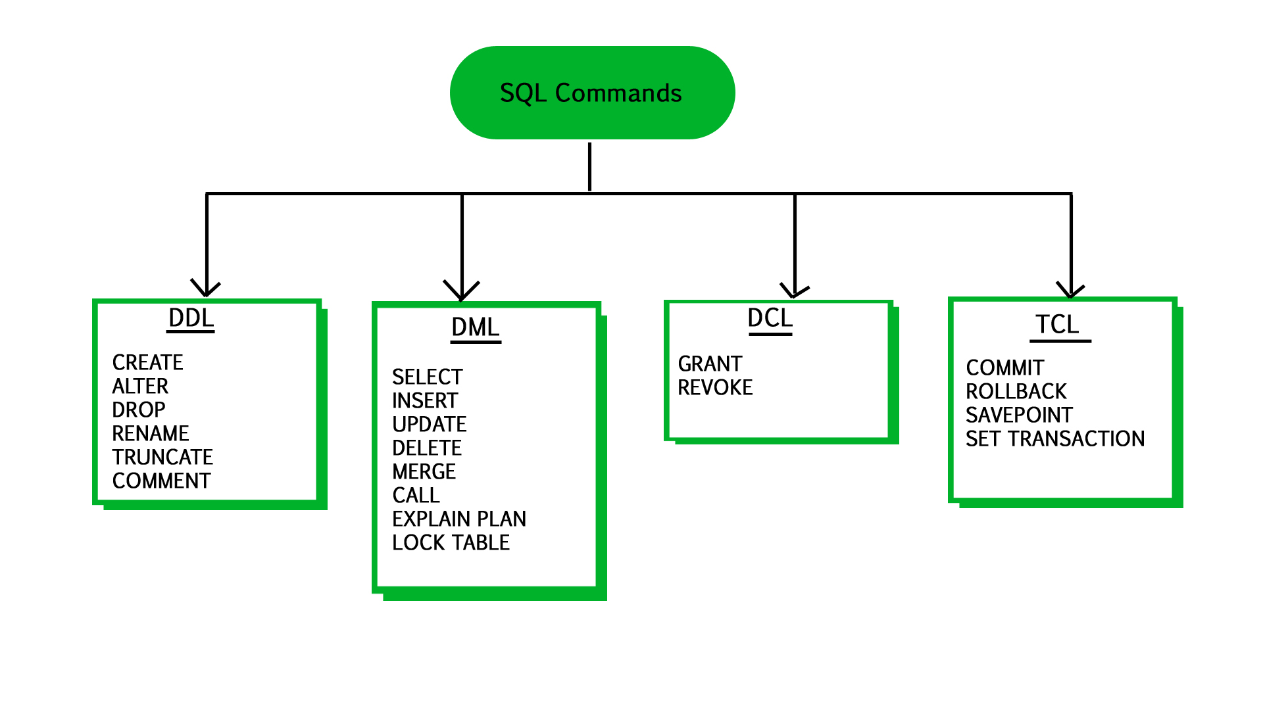
Modify data in tables
User Access
modifying data structures
Version Control
manipulating data
Notes:
Data Definition Language (DDL): Statements for defining and modifying data structures Ex: DROP, ALTER, RENAME, TRUNCATE
Data Manipulation Language (DML): Statements for manipulating data in tables Ex: SELECT, INSERT, UPDATE, DELETE
Data Control Language (DCL): Statements for managing users’ rights Ex: GRANT, REVOKE
Transaction Control Language (TCL);Statements for saving changes; a limited kind of version control Ex: COMMIT, ROLLBACK

Slide 6
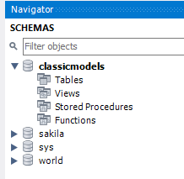
Create a New Database/Schema
Purpose - Creating a container for persistent Data Storage & Retrieval.
Database Description
The classicmodels database is a retailer of scale models of classic cars database. It contains typical business data such as customers, products, sales orders, sales order line items, etc.
Code
CREATE DATABASE classicmodels;
USE classicmodels;
Source: http://www.mysqltutorial.org/mysql-sample-database.aspx

Slide 7
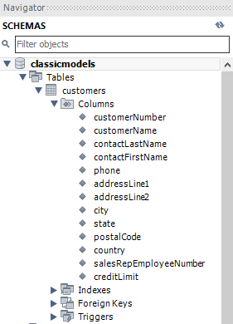
Creating Tables
Purpose - Creating a tabular structure for persistent Data Storage & Retrieval.
use classicmodels;
CREATE TABLE `customers` (
`customerNumber` int(11) NOT NULL,
`customerName` varchar(50) NOT NULL,
`contactLastName` varchar(50),
`contactFirstName` varchar(50),
`phone` varchar(50) NOT NULL,
`addressLine1` varchar(50) NOT NULL,
`addressLine2` varchar(50) DEFAULT NULL,
`city` varchar(50) NOT NULL,
`state` varchar(50) NOT NULL,
`postalCode` varchar(15) NOT NULL,
`country` varchar(50) DEFAULT 'USA’,
`salesRepEmployeeNumber` int(11) DEFAULT NULL,
`creditLimit` decimal(10,2) NOT NULL,
PRIMARY KEY (`customerNumber`),
constraint `limit_chk` CHECK (creditLimit <= 100000)
);
Table & Field Names + Definitions
Field
Constraints
Table Keys - Primary & Foreign
Defined Constraints

Slide 8
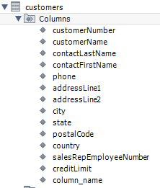
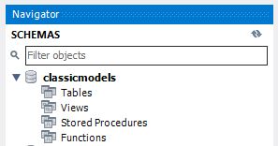
Modifying & Deleting Tables
Purpose - Change (Modify) or Delete (Drop) a tabular structure from the database
Add Column
ALTER TABLE customers ADD column_name varchar(255);
Drop Column
ALTER TABLE customers Drop column_name;
Drop Constraint
DROP constraint `limit_chk`;
Delete
DROP TABLE IF EXISTS `customers`;

Slide 9
Manually Insert Values into Table
Purpose - Store persistent values that allow for the Creation/Extraction of data
insert into classicmodels.customers (`customerNumber`,`customerName`,`contactLastName`,`contactFirstName`,`phone`,`addressLine1`,`addressLine2`,`city`,`state`,`postalCode`,`country`,`salesRepEmployeeNumber`,`creditLimit`) values
(103,'Atelier graphique','Schmitt','Carine ','40.32.2555','54, rue Royale',NULL,'Nantes',NULL,'44000','France',1370,'21000.00'),
(112,'Signal Gift Stores','King','Jean','7025551838','8489 Strong St.',NULL,'Las Vegas','NV','83030','USA',1166,'71800.00')
Result: Select * from customers
customerNumber | customerName | contactLastName | contactFirstName | phone | addressLine1 | addressLine2 | city | state | postalCode | country | salesRepEmployeeNumber | creditLimit
103 | Atelier graphique | Schmitt | Carine | 40.32.2555 | 54, rue Royale | NULL | Nantes | NULL | 44000 | France | 1370 | 21000
112 | Signal Gift Stores | King | Jean | 7025551838 | 8489 Strong St. | NULL | Las Vegas | NV | 83030 | USA | 1166 | 71800

Slide 10
Update Existing Values in Table
Purpose - Store persistent values that allow for the Creation/Extraction of data
update classicmodels.customers
SET city = 'Omaha'
where customerNumber = 103;
Result: Changes the top (Old) record value to bottom (New) values specified in “SET” keyword
customerNumber | customerName | contactLastName | contactFirstName | phone | addressLine1 | addressLine2 | city | state | postalCode | country | salesRepEmployeeNumber | creditLimit
103 | Atelier graphique | Schmitt | Carine | 40.32.2555 | 54, rue Royale | NULL | Nantes | NULL | 44000 | France | 1370 | 21000
103 | Atelier graphique | Schmitt | Carine | 40.32.2555 | 54, rue Royale | NULL | Omaha | NULL | 44000 | France | 1370 | 21000

Slide 11
Delete Records in Table
Purpose - Remove/Delete existing records in a table.
Example: Delete from classicmodels.customers WHERE customerNumber = 112;
Result: Select * from customers (Excludes RED record)
customerNumber | customerName | contactLastName | contactFirstName | phone | addressLine1 | addressLine2 | city | state | postalCode | country | salesRepEmployeeNumber | creditLimit
103 | Atelier graphique | Schmitt | Carine | 40.32.2555 | 54, rue Royale | NULL | Omaha | NULL | 44000 | France | 1370 | 21000
112 | Signal Gift Stores | King | Jean | 7025551838 | 8489 Strong St. | NULL | Las Vegas | NV | 83030 | USA | 1166 | 71800

Slide 12
What is a View?
Purpose - A view is a “virtual table” based on the result-set of an SQL statement, saved as a database object for future data creation/extraction.
SQL Views have the following properties:
A view is a named derived table.
CREATE/ALTER/DROP VIEW clauses
Views are not stored and its query must be run every time it is needed.
Used to call up data without changing its underlying base tables.
Example
CREATE VIEW world.vw_countries_asia AS
SELECT tbl.Name AS 'Country'
FROM world.country as tbl
WHERE (tbl.Continent = 'Asia')
View Usage
SELECT country
FROM world.vw_countries_asia
WHERE Country in ('India', 'China', 'Nepal')
Notes:
A derived table is the result of a query that looks like a table.

Slide 13

Exercises
Data Storage & Manipulation
(Class 3 Exercise - Data Manpulation Pt1.sql)
1. Create a schema named “MissingPersons”
2. Create a table in “MissingPersons” schema named “Person”, with the following qualities:
Fields: ID, LastName, FirstName, Age
Primary Key: ID
Field Constraints: Not Nullable
3. Alter the table to include (add) a “Gender” field.
4. Insert the following records into the table:
(1,'Doe','Jane',42,’F’) ,(2,'Doe','John',57,’M’),
(3,'Presley','Elvis',82,’M') ,(4,'Shakur','Tupac',49,’M’)
Delete the record with “LastName” = “Presley”
6. Update the LastName in the record that contains “ID” = 4 to “LastName” = ‘Crooks’
7. delete the column “First Name” from the table
8. drop the “Person” table from the “MissingPersons” schema.
Notes:
SET SQL_SAFE_UPDATES = 0;

Slide 14
Data Manipulation Pt. 2
Jeremy Bergmann - Omaha Data Science Academy

Slide 15
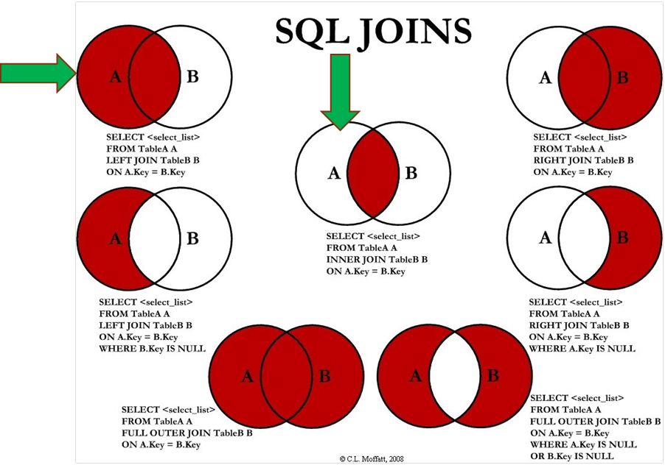
How do you combine data?
Answer:
SQL Joins can be done using WHERE or JOIN clauses!
Notes:
Most Common - INNER & LEFT, Sometimes Full Outer

Slide 16
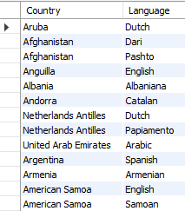
Inner Join - Example
Syntax SELECT <columns> FROM <table> AS <alias> <join type> JOIN <table> AS <alias>
ON <table alias>.<table column> = <table alias2>.<column>
Example - Official Languages SELECT a.Name as Country, b.Language FROM world.country as a INNER JOIN world.countrylanguage as b ON a.code = b.countryCode and b.IsOfficial ='T'

Slide 17
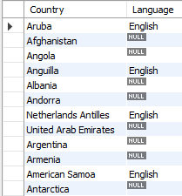
Left Join - Example
Question: “Which countries do/do not speak English as a language?”
Example
SELECT a.Name as Country, b.Language FROM world.country as a LEFT JOIN world.countrylanguage as b ON a.code = b.countryCode and b.`Language` ='English'
Notes:
Security: databases have additional security measures
Data integrity: data changes require intent
Customization: you can organize it best on your needs
Recovery: you don’t lose the data if there’s a catastrophic error
Learning curve: you have to learn how to manipulate it
Abstract: a less visual representation and demands more from the user

Slide 18
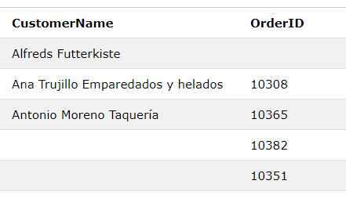
Full Outer Join - Example
Question: “List all Customer and Order Name, regardless of a customer placing an order, or an order without a customer name”
Example
SELECT a.CustomerName, b.OrderID FROM Customers as a FULL OUTER JOIN Orders b ON a.CustomerID=b.CustomerID ORDER BY a.CustomerName;

Slide 19
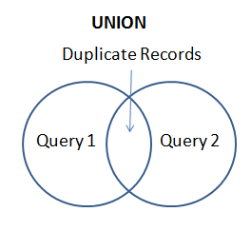
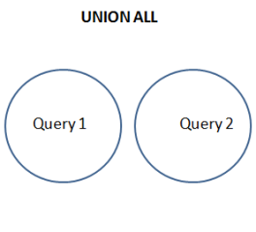
SQL Union & Union All
Purpose: The UNION operator is used to combine the result-set of two or more SELECT statements.
Each SELECT statement within UNION must have the same number of columns
The columns must also have similar data types
The columns in each SELECT statement must also be in the same order

Slide 20
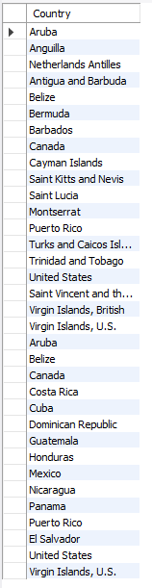
SQL Union All
Example
SELECT a.Name as Country FROM world.country as a Inner JOIN world.countrylanguage as b ON a.code = b.countryCode and b.`Language` ='English' Where a.Continent = 'North America' Union All SELECT a.Name as Country FROM world.country as a Inner JOIN world.countrylanguage as b ON a.code = b.countryCode and b.`Language`='Spanish' Where a.Continent = 'North America'
Question: “List all countries in North America that speak English or Spanish as a language, with duplication.
/

Slide 21
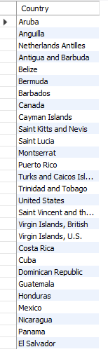
SQL Union
Question:
“List all countries in North America that speak English or Spanish as a language, with no duplication.
Example
SELECT a.Name as Country FROM world.country as a Inner JOIN world.countrylanguage as b ON a.code = b.countryCode and b.`Language` ='English' Where a.Continent = 'North America' Union SELECT a.Name as Country FROM world.country as a Inner JOIN world.countrylanguage as b ON a.code = b.countryCode and b.`Language`='Spanish' Where a.Continent = 'North America'

Slide 22
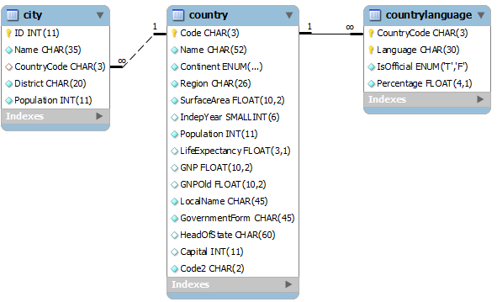
Exercises
SQL Joins & Unions (Class 4 Exercise - Data Manipulation Pt2.sql)
1. Using a union on the world.country table, combine all countries (repeating) with a life expectancy of > 80 years or a GNP > 1000000, with no repeats.
2. List all official languages spoken in the 'Southeast Asia' region.
3. List all the countries in North America, then match (left join) the “percentage” of the population that speaks English.
4. In the “world” schema, obtain the name of all cities in North America that have a population over 1M, where the primary language is English or Spanish (with repeats).
Notes:
Schema: https://gist.github.com/mdang/9a4a8063ebea3b829b8025746643ade1

Slide 23
Project Milestones
Import data into MySQL database (Class 1)
Query Data for Data Understanding/Relevant Information (Class 1)
Storing/Joining data for analysis (Class 2)
Cleaning Data for Analysis (Class 3)
Analyze Data Quality & Create Data Dictionary (Class 3)
Normalize Data & Create Data Model (Class 4)
Connect Data to BI Tool, Answer Business Questions, Automate data workflow using ETL (Optional) (Class 5)

Slide 24

Class Project
Data Storage & Manipulation
1. The business is in need of storing additional video game sales data, to understand the current “top games” in the marketplace.
Create a table named “console_game_sales” in the consoles schema, using the “ConsoleGames_201905.csv” file in the “Class Project/consoles” folder
Create a SQL script that inserts the values of the CSV file, into the “console_game_sales” table.
2. The company is not interested in producing Sports Games - Remove these observations from the “console_game_sales” table
3. The CEO insists that “Barbie Adventure Game” is a top-seller. Insert a record with that “Title” into the table, for comparison purposes (created “dummy” record/field values)
Notes:
from https://www.gamerankings.com/

Slide 25
Class Project
SQL Joins & Unions
To better understand the marketplace for video games and consoles, the COO would like to know the answer to the following questions:
1. What are the total sales for Action vs. Role-Playing games in North America by Year, since 2000?
2. During that time period, how does Role-Playing game sales compare vs. other Genres? (Combine all Countries)
3. What is the most popular console (by NA Sales) for Role Playing games, for consoles with a “first_retail_availablity” since 2000?
4. Obtain the average rank of games created in 2014, by genre. How does this order compare with the current video game rankings in the “console_game_sales” table?
5. Does this lead you to additional questions to research or data to gather?
Notes:
https://www.kaggle.com/max-mind/world-cities-database
https://www.kaggle.com/gregorut/videogamesales

